Slide 1
An overview on derechos
Brian Squitieri, Ph.D.
Storm Prediction Center
National Weather Service

Slide 2
What is a derecho?
Historically, the term derecho has been applied ambiguously
Lack of agreement as to the specific criteria needed to confirm a derecho
What storm modes and ambient environments support such events
Should internal storm-scale mechanisms matter in derecho production? Think of the differences between supercell-tornadoes vs. landspouts for example.
There is a general understanding (agreement) that derechos are widespread severe windstorms originating from MCSs (or organized, mostly linear convection)
What makes a given event a derecho in the eyes of the meteorology community, broadcast media, stakeholders, or the public?
“You know it when you see it.”

Slide 3
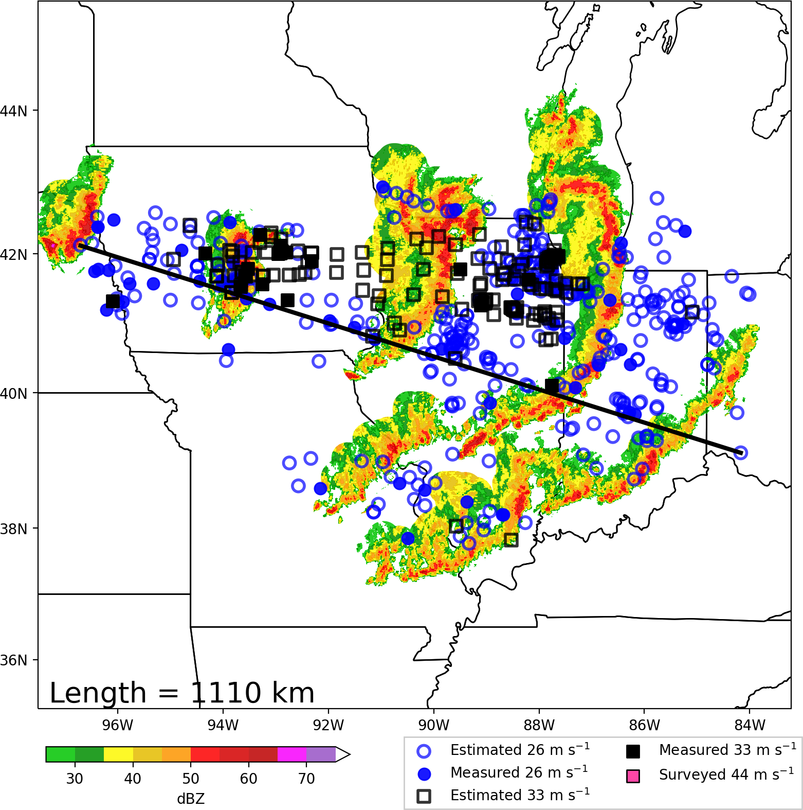
What is a derecho?
(a)

Slide 4
What is a derecho?
(a)
Parent MCS is known as the derecho-producing MCS (DMCS)

Slide 5
What is a derecho?
(a)
DMCS
Parent MCS is known as the derecho-producing MCS (DMCS)

Slide 6
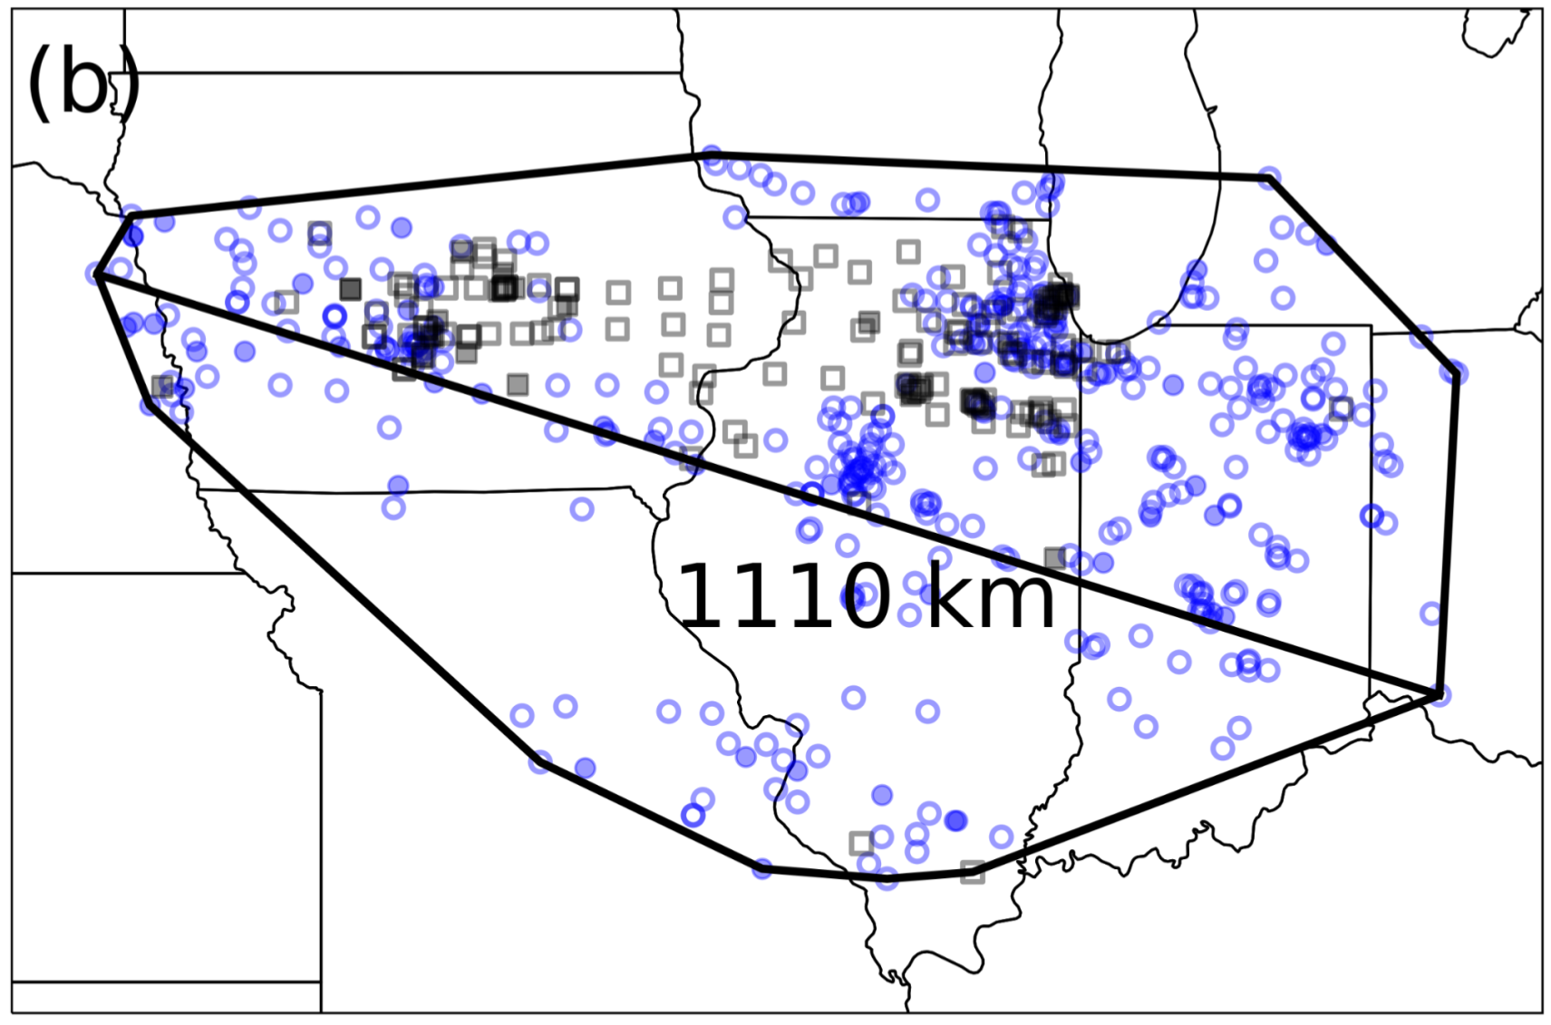
What is a derecho?
(a)
DMCS
Parent MCS is known as the derecho-producing MCS (DMCS)

Slide 7
What is a derecho?
(a)
Derecho
DMCS
Parent MCS is known as the derecho-producing MCS (DMCS)
The derecho is the series of downbursts, evident via swaths of wind reports
Calling an MCS a derecho is like calling a supercell a tornado.

Slide 8
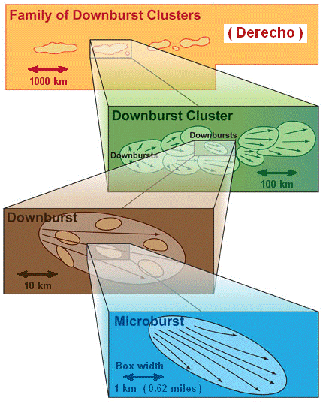
What is a derecho?
Downburst winds occur on varying scales of motion.
Typically, instances of stronger winds occur within increasingly shorter-lived, shorter-tracked, narrower swaths.
Analogous to stronger winds contained within single-suction vortices of multiple-vortex tornadoes.

Slide 9
Defining Derechos
Johns and Hirt (1987) was the first to robustly study derechos, identifying progressive/serial derecho types in the process.
Quantitative criteria were introduced to stratify between potent wind swaths and more ordinary severe wind events.
Defined derechos as “widespread windstorms originating from a singular MCS”

Slide 10
Defining Derechos
Corfidi et al. (2016) proposed a new derecho definition:
“A family of damaging downburst clusters associated with a forward-propagating, mesoscale convective system (MCS) that, during part of its existence, displays evidence of one or more sustained bow echoes with mesoscale vortices and/or rear-inflow jets.”
The proposed definition would exclude serial squall line events, which were hypothesized to be driven primarily be downward momentum transport of the synoptic flow aloft.
The purpose of this definition modification was to associate the phrase ‘derecho’ to a phenomenological occurrence.
A phenomena is a unique observation, driven by a specific cause, that is recurrent in nature.

Slide 11
Derecho Classification
What are the quantitative criteria that a wind swath must meet to be classified as a derecho?

Slide 12
 | Johns and Hirt (1987) JH87 | Bentley and Mote (1998) BM98 | Bentley and Sparks (2003) | Coniglio and Stensrud (2004) CS04 | Corfidi et al. (2016) C16
Years | 1980-1983 | 1986-1995 | 1986-2000 | 1986-2001 | 2010-2014
N | 70 | 112 | 230 | 244 | 365 (25)
Type | Progressive Serial | Progressive Serial | Progressive Serial | Progressive Serial | Progressive
1 | There must be a concentrated area of convective wind gusts exceeding 26 m s⁻¹ with a major axis path length of at least 400 km. | As in JH87 | As in JH87 | As in JH87 | Like JH87, but for a path length of 650 km (N = 25 cases that met this length criteria).
2 | There must be at least 3 reports (separated by 64 km) of F1 damage or 33+ m s⁻¹ wind gusts during the MCS stage. | Not Used | As in BM98 | Low end: BM98 Moderate: JH87 High end: Like JH87, but 3 reports must exceed 38 m s⁻¹, with 2 occurring at MCS stage. | As in BM98
3 | No more than 3 h can elapse between successive reports. | No more than 2 h can elapse between successive reports. | As in BM98 | Like JH87, but for 2.5 h. | No more than 1 h elapsed between successive reports.
4 | Wind reports must have chronological progression. | As in JH87 | As in JH87 | As in JH87 | As in JH87
5 | The associated MCS must have spatial or temporal continuity in surface pressure or wind fields. | Continuity confirmed when no more than 2º lat/lon separation occurs between reports. | As in BM98 | Like BM98, but no more than 200 km allowed between any reports in the swath. | Like CS04, but no more than 100 km allowed between any reports in the swath.
6 | All damage swaths must accompany the same MCS based on radar data. | MCS confirmed by temporally mapping wind reports without radar data. | As in BM98 | As in JH87 | As in JH87

Slide 13
Focusing the Derecho Definition
Varying quantitative criteria classifying derechos introduces sensitivity to spatial climatology and overall annual frequency
Previous derecho studies evaluated events over smaller periods of time, which can also influence climatology results
A need arises for a more consistently applied definition and associated quantitative criteria to better understand the mechanisms and ambient environments supporting the most intense, destructive wind swaths. Can also derive a more accurate spatial climatology.

Slide 14
Focusing the Derecho Definition
In agreement with Corfidi et al. (2016), the first step to better understanding derechos would be to define these events in a phenomenological sense.
In tradition with many earlier studies, an intensity component to derechos is necessary to make such events phenomenally distinct.
Defining derechos as widespread severe wind swaths originating from self-organized, cold-pool driven MCSs (as in Corfidi et al. 2016) accomplishes the ‘phenomenological’ component of the definition.
Past research has shown that the most impactful feature to derecho wind swaths was the existence of multiple embedded 33+ m s⁻¹ wind gusts (Squitieri et al. 2023a, b). Including multiple 33+ m s⁻¹ wind gusts will make derechos phenomenally distinct.
Many past studies (going back to Johns and Hirt 1987) noted the distinct phenomenal occurrence of derechos moving faster (sometimes much faster) than the mean wind speed.

Slide 15
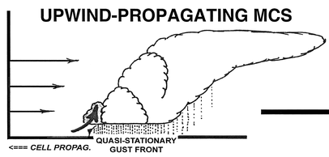
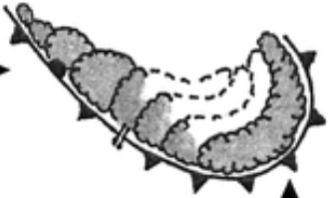
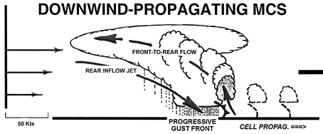
MCS Forward Motion
Recall that progressive cold pools can be heavily influential on MCS forward (downwind) propagation.
V_{Prop-Upwind}
V_{Prop-Upwind}?
V_{Prop}
50 kts
V_{Prop}

Slide 16
MCS Forward Motion Factors
Downwind-propagating MCSs are dominated by the cold pool, and derechos are also produced by cold-pool-driven MCSs, which are dominated by internal forcing mechanisms.
As such, V_{downwind} would be a useful vector for monitoring derecho progression.
Note that V_{downwind} is a longer vector than V_{CL}.
V_{Upwind}
V_{CL}
V_{Downwind}

Slide 17
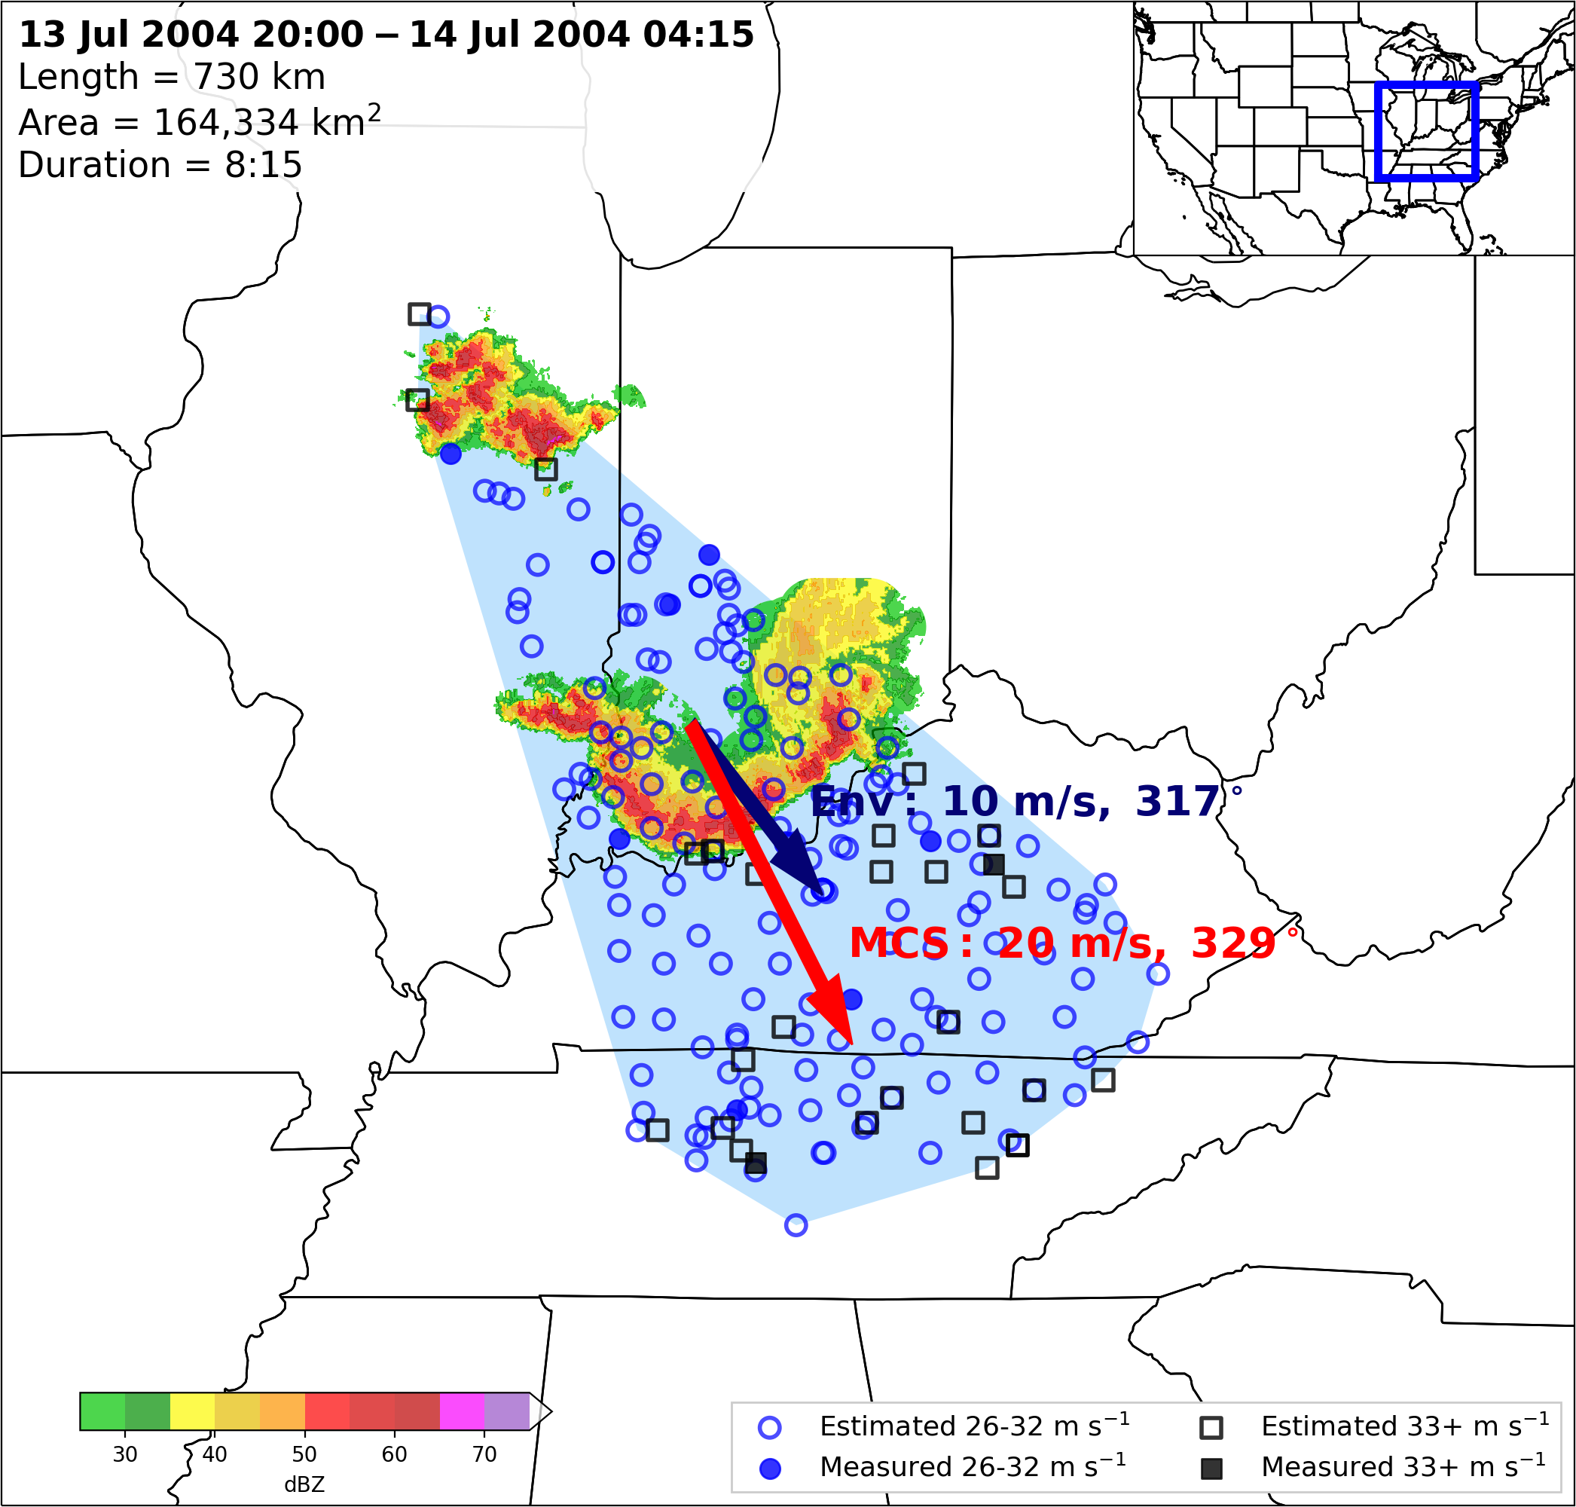
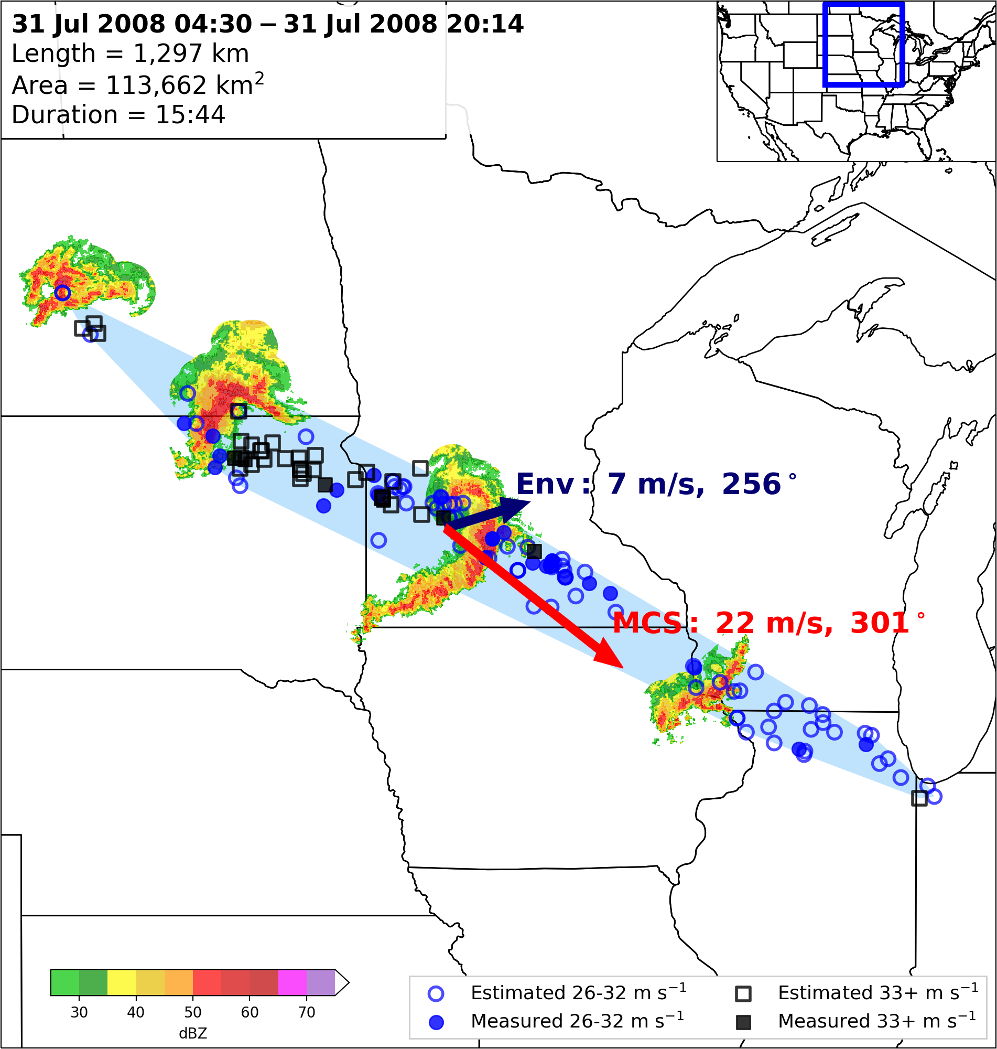
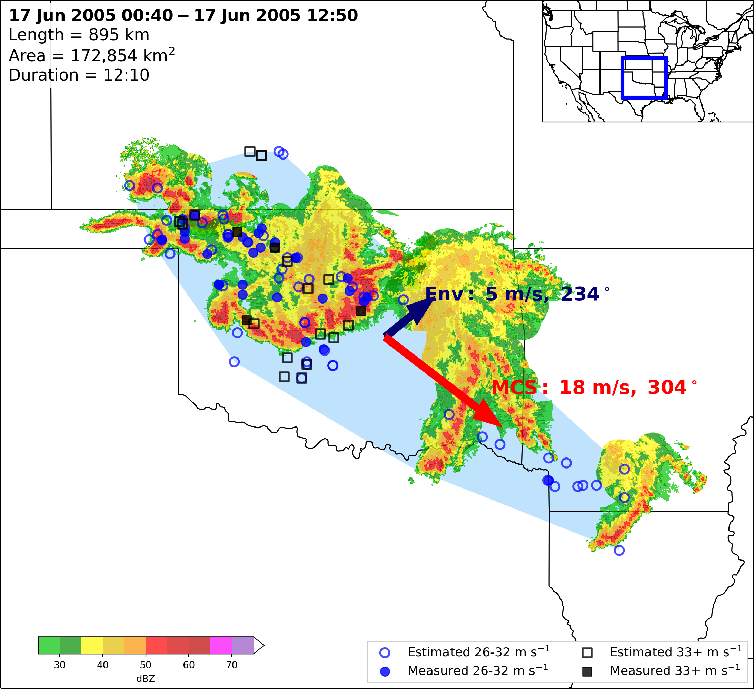
MCSs moving faster than the mean wind speed is an excellent discriminator between cold-pool-driven MCSs and their squall line counterparts.

Slide 18
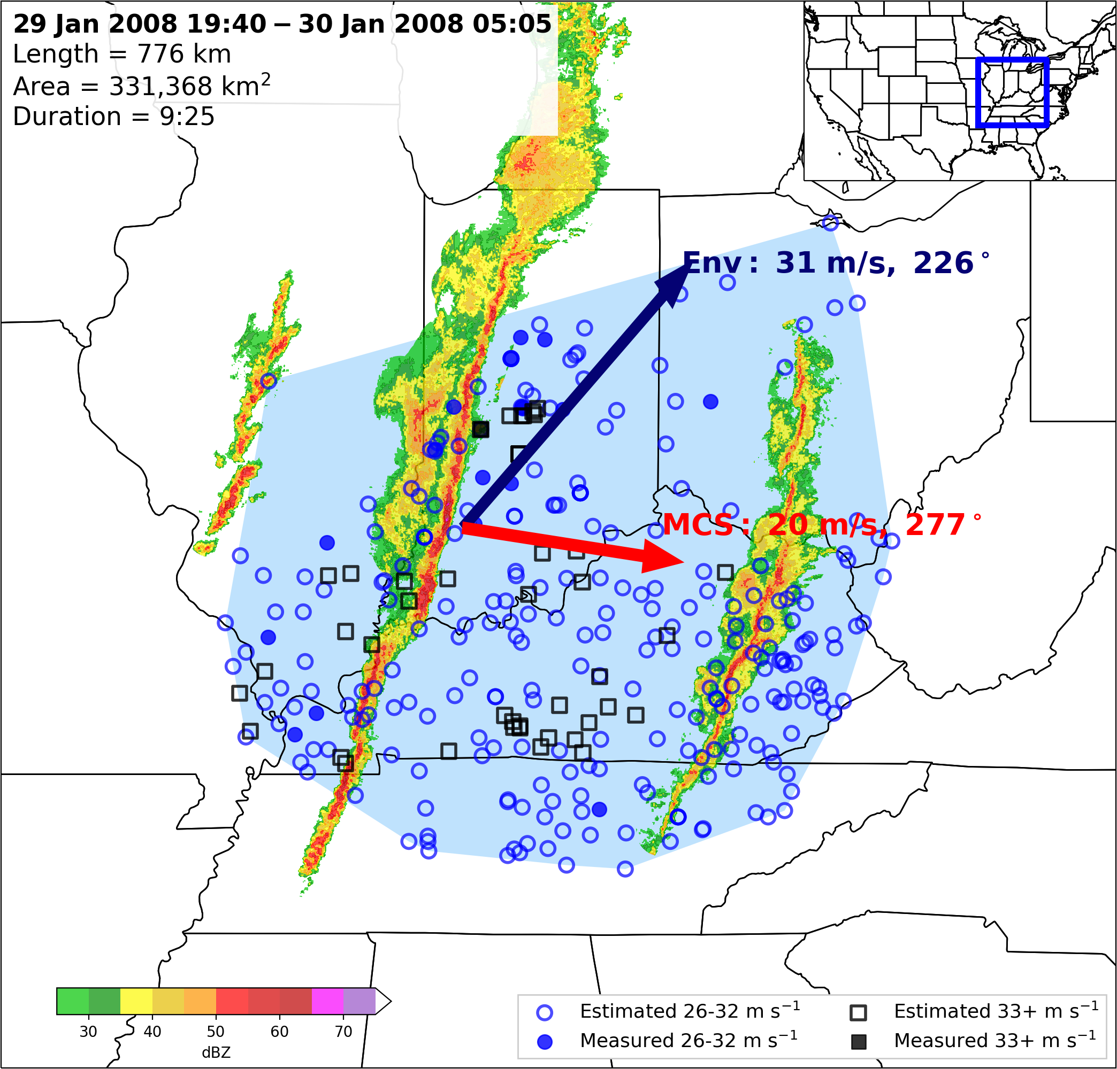
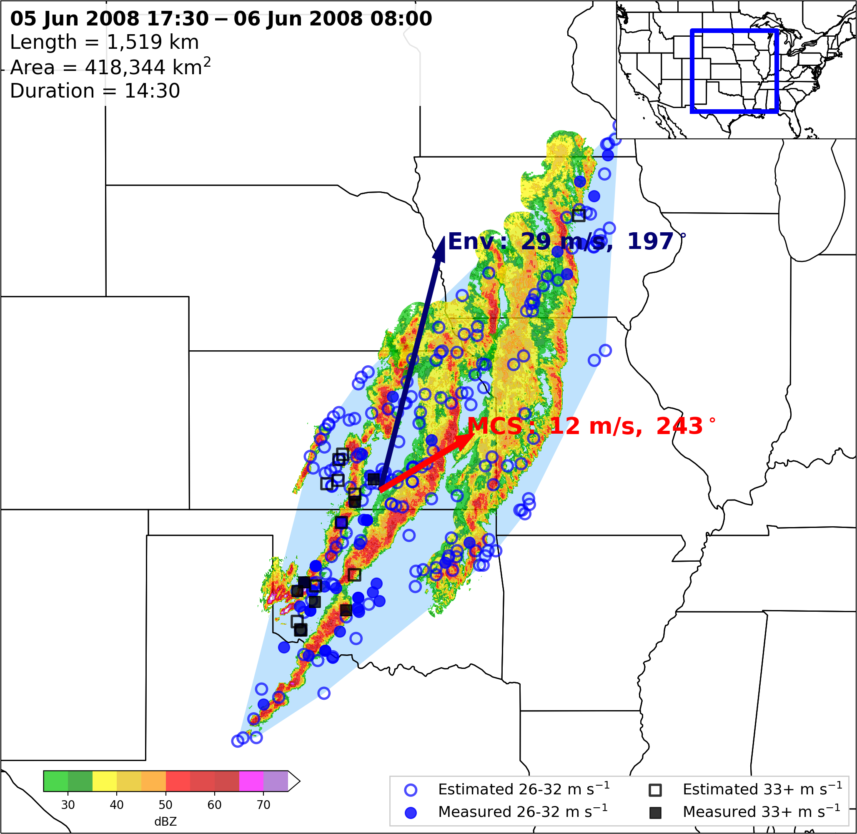
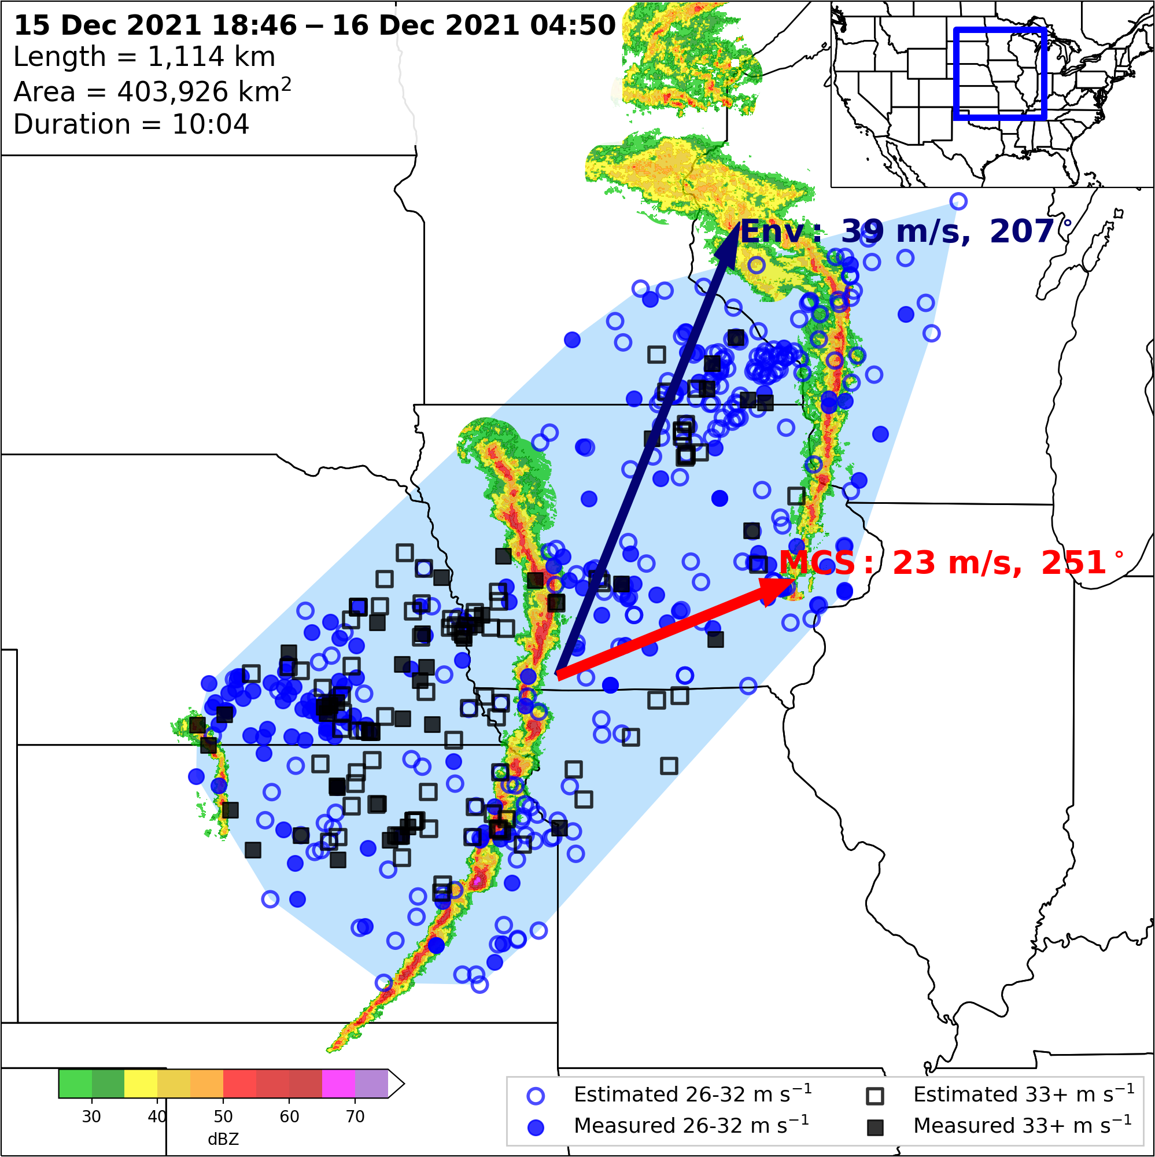
MCSs moving faster than the mean wind speed is an excellent discriminator between cold-pool-driven MCSs and their squall line counterparts.
Note: Cold-pool-driven MCSs and strongly forced squall lines both have degrees of internal and external forcing (i.e. a level of contribution from the cold pool
The argument is that to define derechos as a distinct phenomena, internal forcing mechanisms must dominate, which is defined by the MCS moving faster than the full mean wind speed.

Slide 19
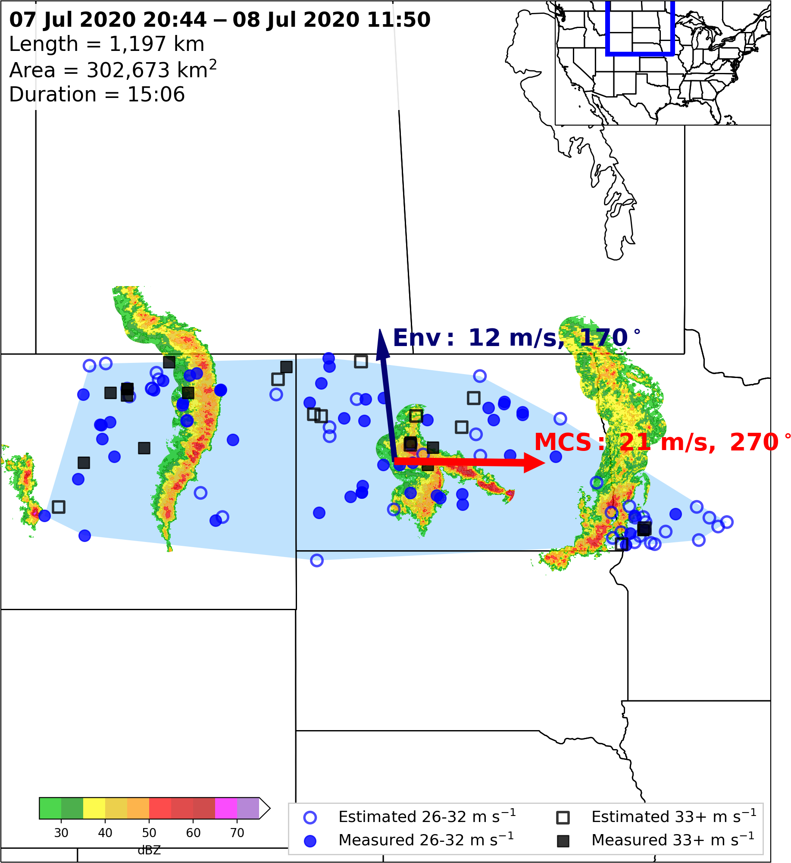
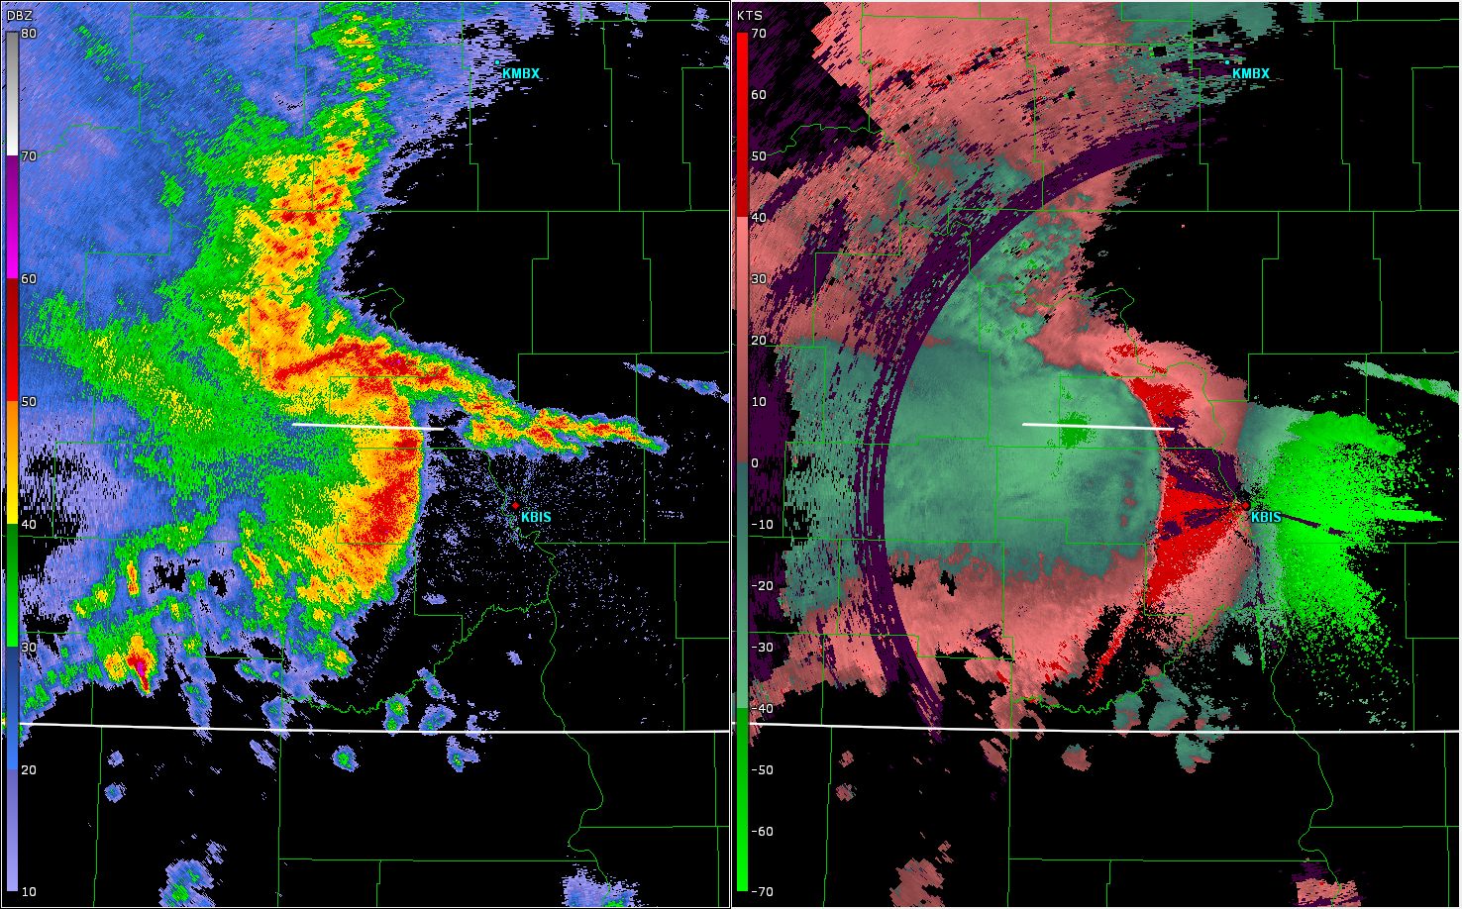
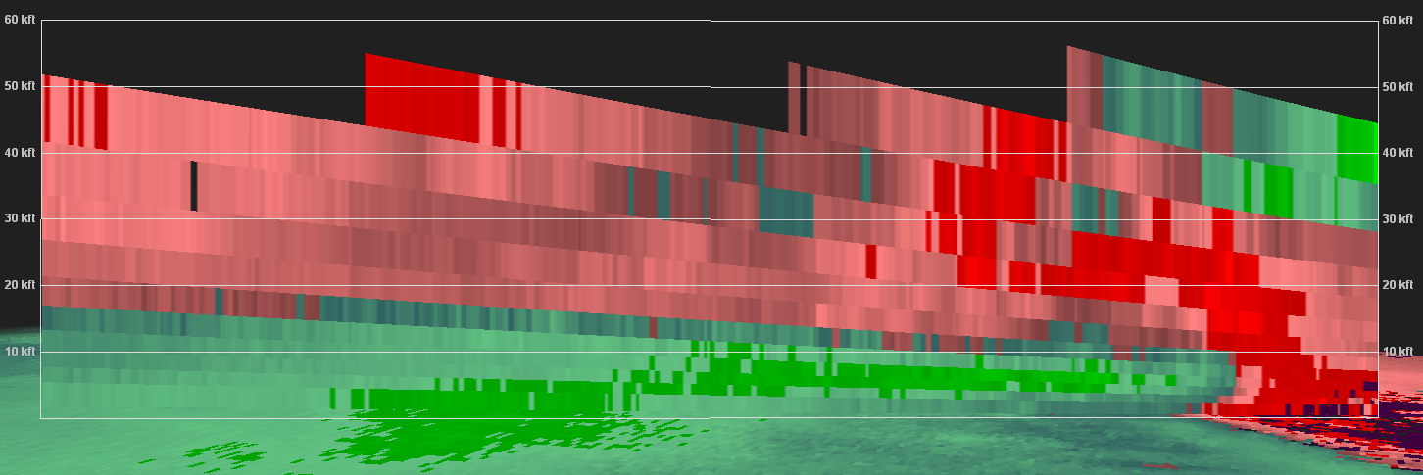
0414 UTC 08 July 2020
Storm Relative Velocity Scan
234 Degrees / 46 kts
Line-End
Mesovortex
A
B
A
B
KBIS
Bow-Echo DMCS
Descending
Rear-Inflow Jet
Regional
Radar
Domain
Regional
Radar
A
B

Slide 20
Modified Derecho Definition
“A widespread severe windstorm characterized by a family of destructive downbursts containing hurricane-force gusts associated with an extra-tropical, cold-pool-driven Mesoscale Convective System.”
For a wind swath to be classified as a derecho, the following criteria are needed:
Widespread severe reports (wind damage or 26+ m s⁻¹ gusts) comprising the wind swath all occur from the same MCS.
All reports in the wind swath must occur in progressive sequence.
The MCS must move faster than the full mean wind speed.
No more than 1 h may elapse between reports in the wind swath.
Spatial gaps between reports in the wind swath may not exceed 200 km.
The wind swath must be at least 400 km long.
At least five 33+ m s⁻¹ gust reports (separated by 80 km) must occur in the 400-km long wind swath.
At least three measured 33+ m s⁻¹ (separated by 80 km) are required in the wind swath.

Slide 21
 | Johns and Hirt (1987) JH87 | Bentley and Mote (1998) BM98 | Bentley and Sparks (2003) | Coniglio and Stensrud (2004) CS04 | Corfidi et al. (2016) C16 | Squitieri et al. (2025a)
Years | 1980-1983 | 1986-1995 | 1986-2000 | 1986-2001 | 2010-2014 | 2000-2022
N | 70 | 112 | 230 | 244 | 365 (25) | 70
Type | Progressive Serial | Progressive Serial | Progressive Serial | Progressive Serial | Progressive | Progressive
1 | There must be a concentrated area of convective wind gusts exceeding 26 m s⁻¹ with a major axis path length of at least 400 km. | As in JH87 | As in JH87 | As in JH87 | Like JH87, but for a path length of 650 km (N = 25 cases that met this length criteria). | As in JH87
2 | There must be at least 3 reports (separated by 64 km) of F1 damage or 33+ m s⁻¹ wind gusts during the MCS stage. | Not Used | As in BM98 | Low end: BM98 Moderate: JH87 High end: Like JH87, but 3 reports must exceed 38 m s⁻¹, with 2 occurring at MCS stage. | As in BM98 | At least 5 reports (separated by 80 km) of 33+ m s⁻¹ wind gusts during the MCS stage. At least 3 reports must be measured at 33 m s⁻¹.
3 | No more than 3 h can elapse between successive reports. | No more than 2 h can elapse between successive reports. | As in BM98 | Like JH87, but for 2.5 h. | No more than 1 h elapsed between successive reports. | As in C16
4 | Wind reports must have chronological progression. | As in JH87 | As in JH87 | As in JH87 | As in JH87 | As in JH87
5 | The associated MCS must have spatial or temporal continuity in surface pressure or wind fields. | Continuity confirmed when no more than 2º lat/lon separation occurs between reports. | As in BM98 | Like BM98, but no more than 200 km allowed between any reports in the swath. | Like CS04, but no more than 100 km allowed between any reports in the swath. | As in CS04
6 | All damage swaths must accompany the same MCS based on radar data. | MCS confirmed by temporally mapping wind reports without radar data. | As in BM98 | As in JH87 | As in JH87 | As in JH87

Slide 22
Derecho Climatology

Slide 23
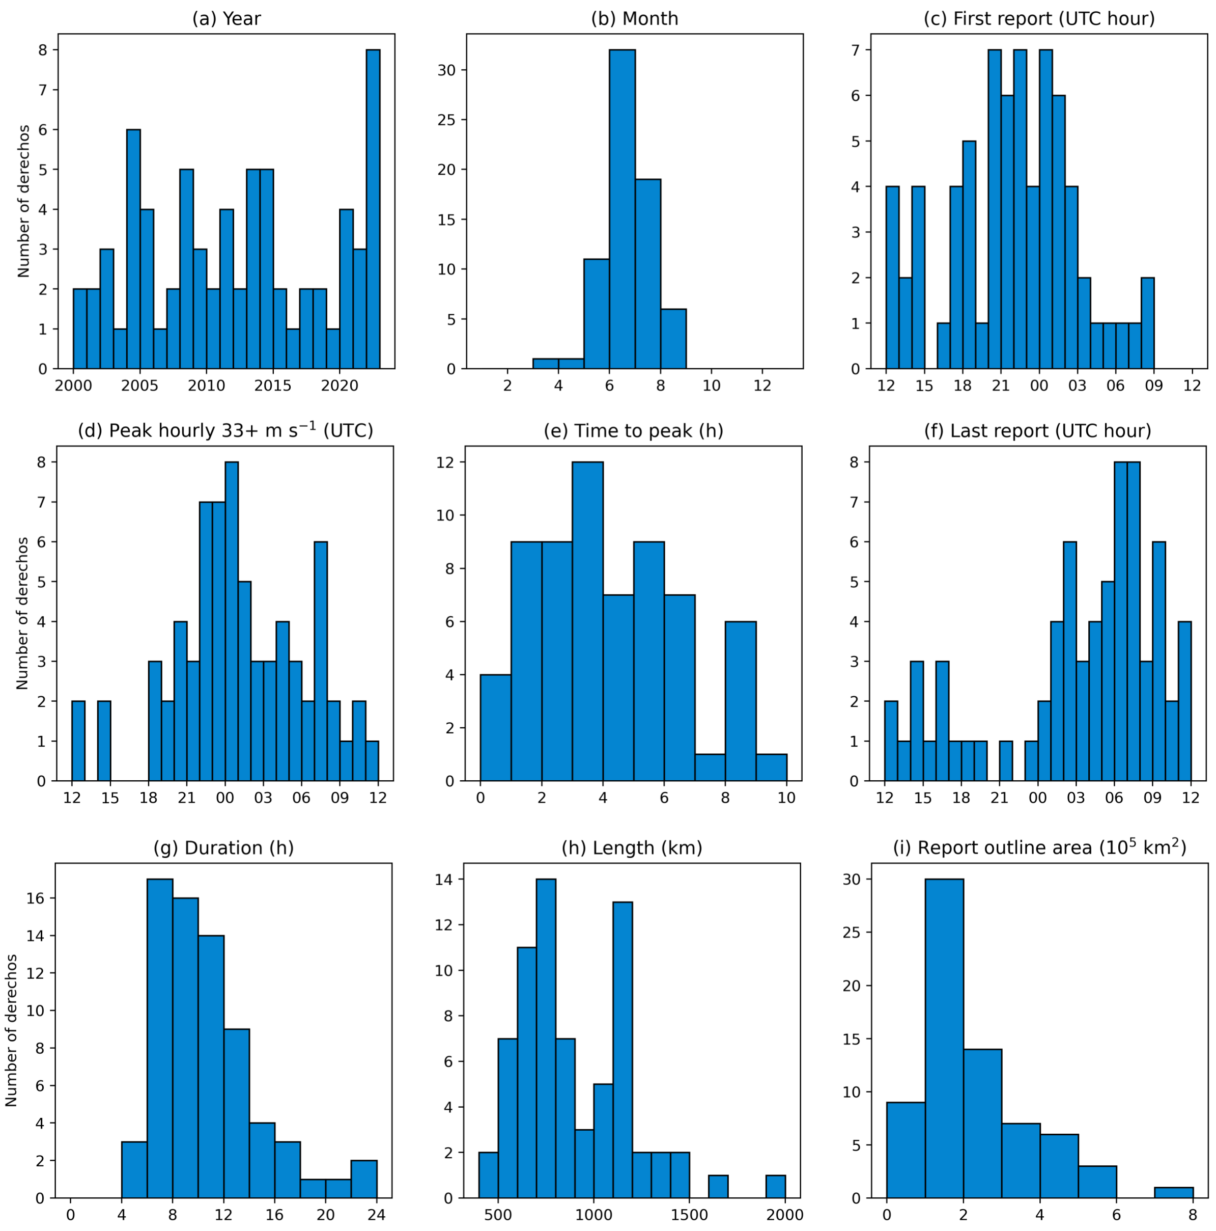

Slide 25
~5 derechos
per yr
~1.5 derechos
per yr
~1.5 derechos
per yr
~1.5 derechos
per yr

Slide 26
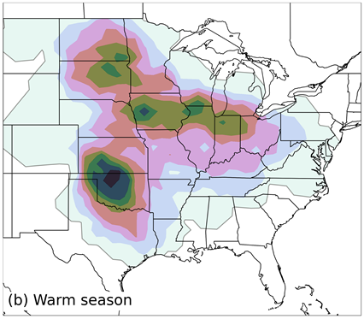
~5 derechos
per yr
~1.5 derechos
per yr
~1.5 derechos
per yr
~1.5 derechos
per yr

Slide 27
~5 derechos
per yr
~1.5 derechos
per yr
~1.5 derechos
per yr
~1.5 derechos
per yr
~1 derecho
per 2 yrs
About 1 derecho
per yr

Slide 28
How do bow-echo DMCSs form?

Slide 29
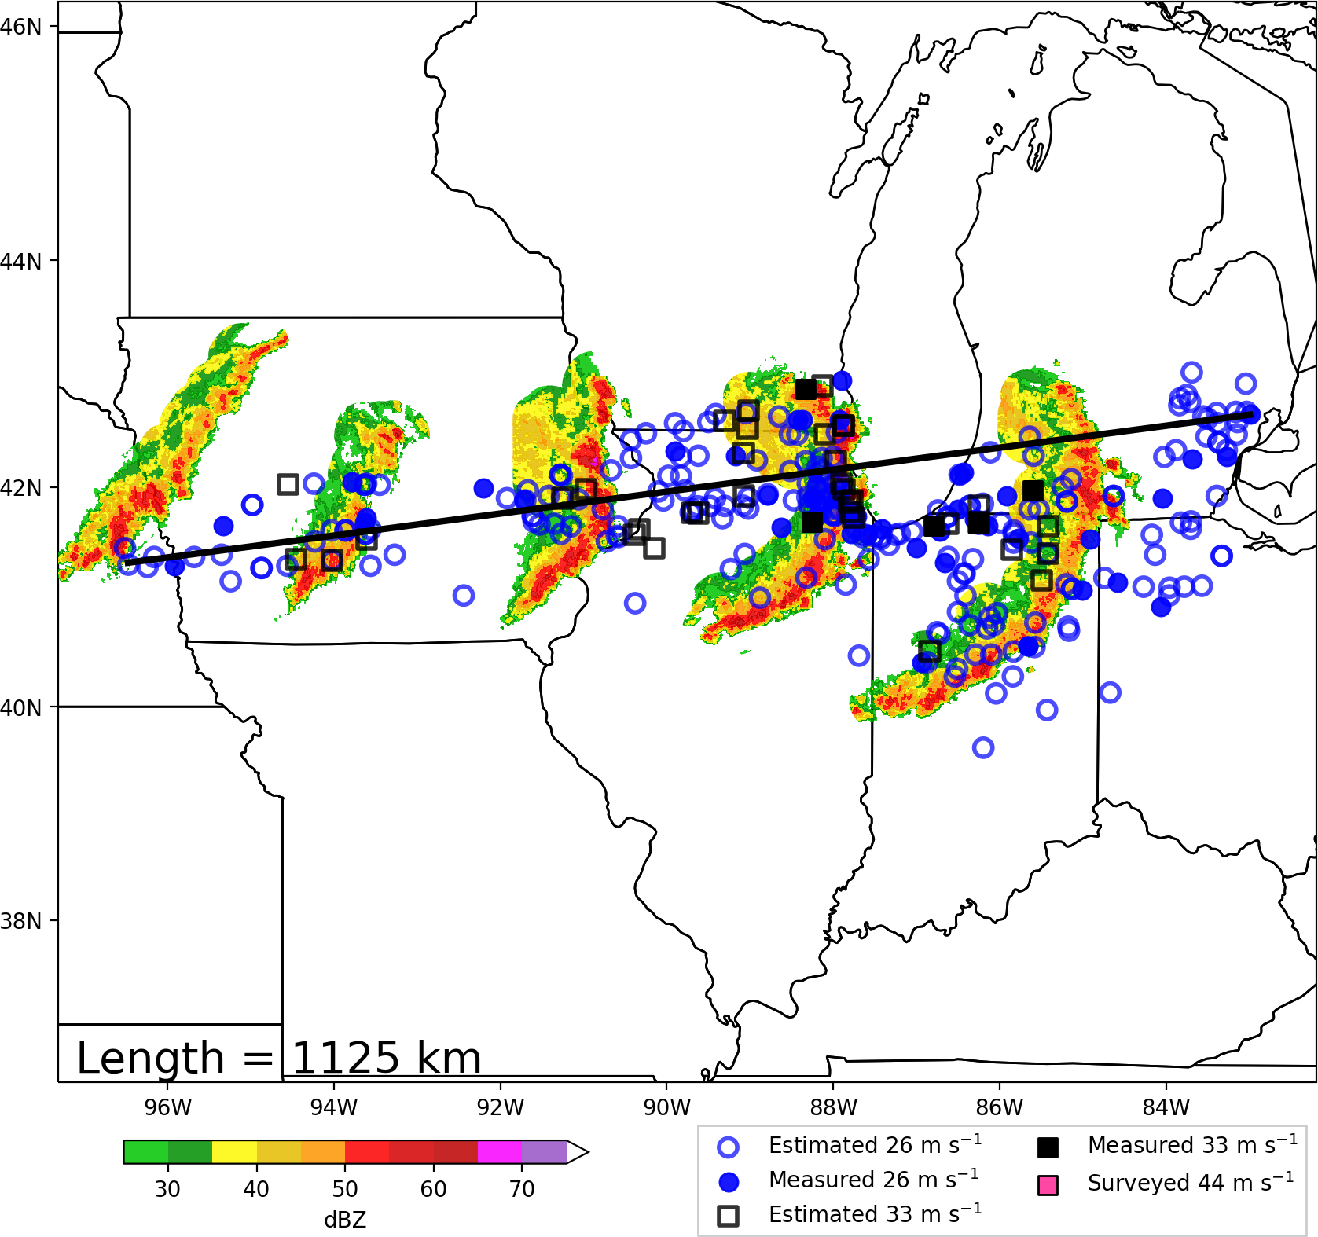
How do bow-echo DMCSs form?

Slide 30
How do bow-echo DMCSs form?

Slide 31
How do bow-echo DMCSs form?
Lets do a
Theoretical
Cross-section!
Looking
North

Slide 32
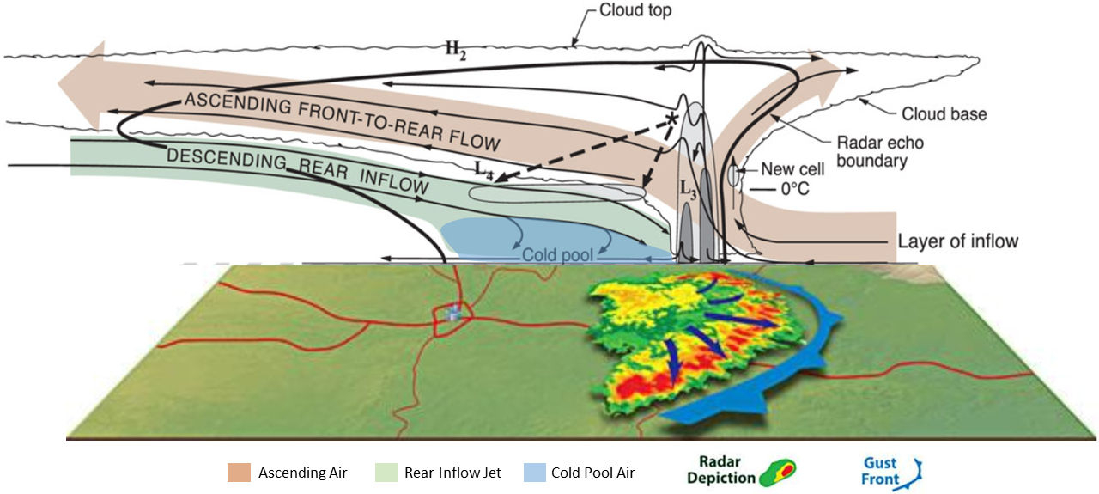
How do bow-echo DMCSs form?

Slide 33
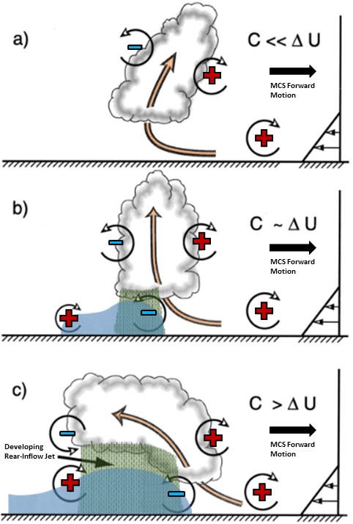

Slide 34
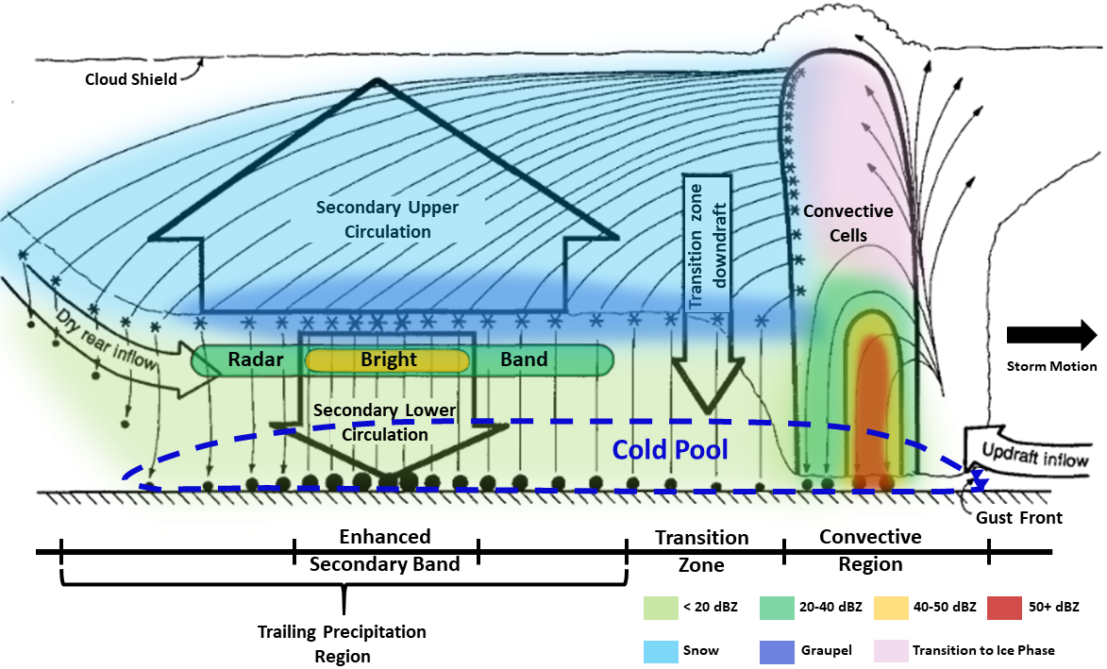

Slide 35
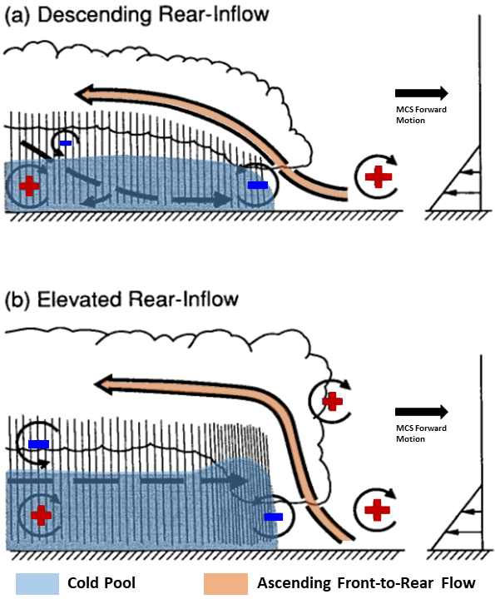

Slide 36
Ordinary MCSs

Slide 37
Ordinary MCSs
Long-lived
bow-echo MCSs
And DMCSs

Slide 38
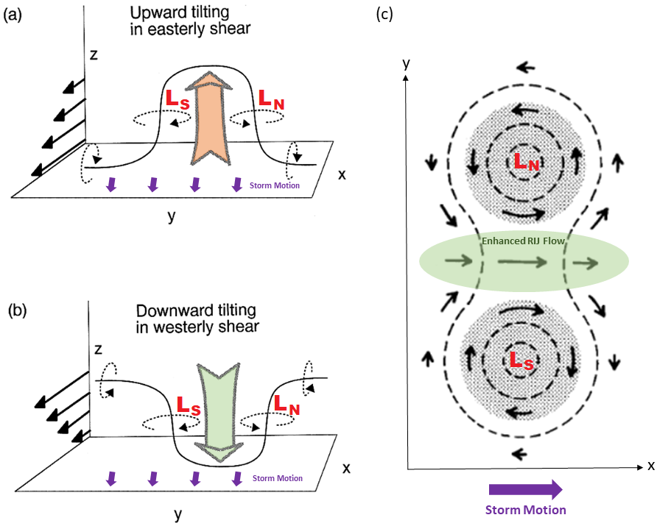

Slide 39
Northern vortex dominates
due to Coriolis force

Slide 40
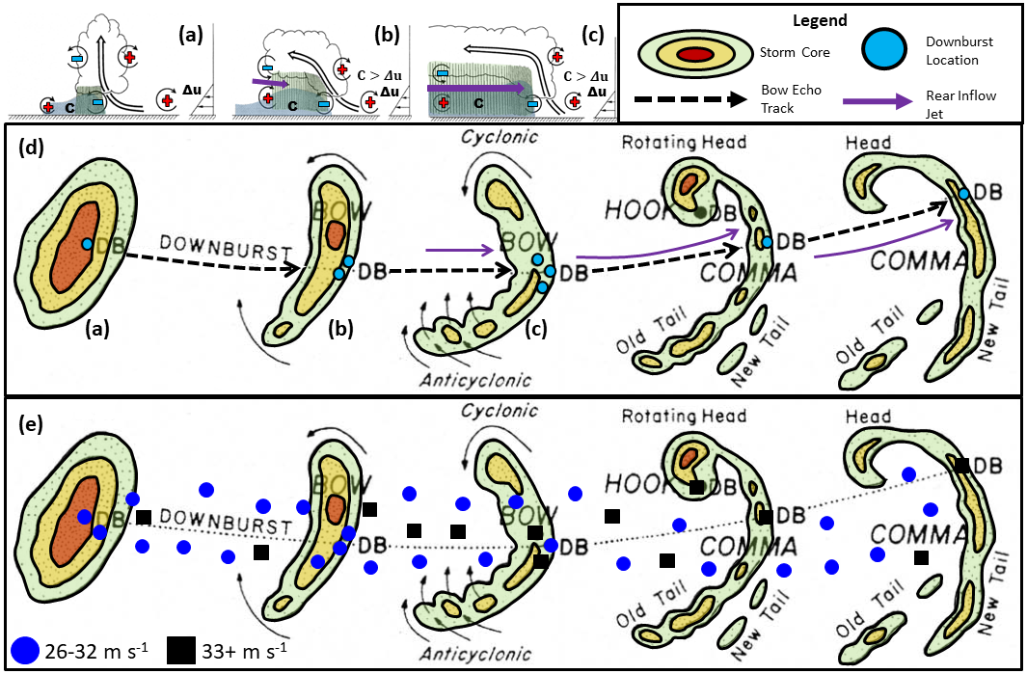

Slide 41
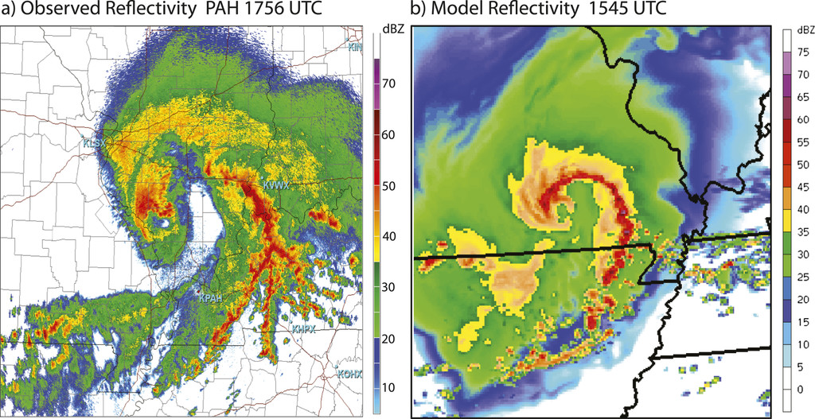
08 May 2009 “Super-Derecho” Case
Weisman et al. (2013)

Slide 42
Line-End
Mesovortex
Area favorable for
leading-line/system-scale
mesovortices
08 May 2009 “Super-Derecho” Case
Weisman et al. (2013)

Slide 43
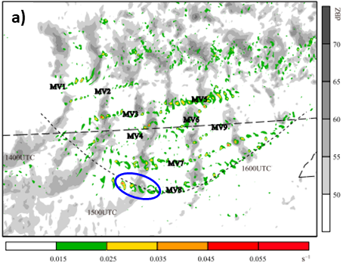
Missouri
Arkansas

Slide 44
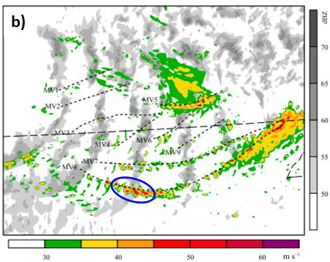
Missouri
Arkansas

Slide 45
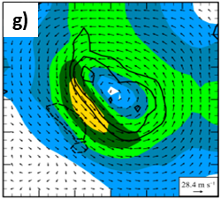
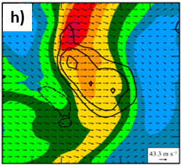
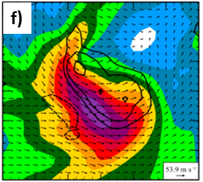
Vortical Flow
Background Flow
Total Flow

Slide 46
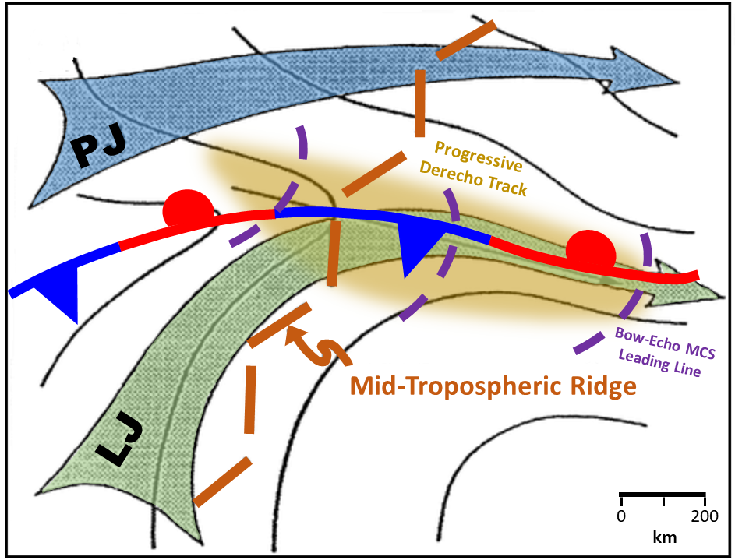
Derecho Environments

Slide 47
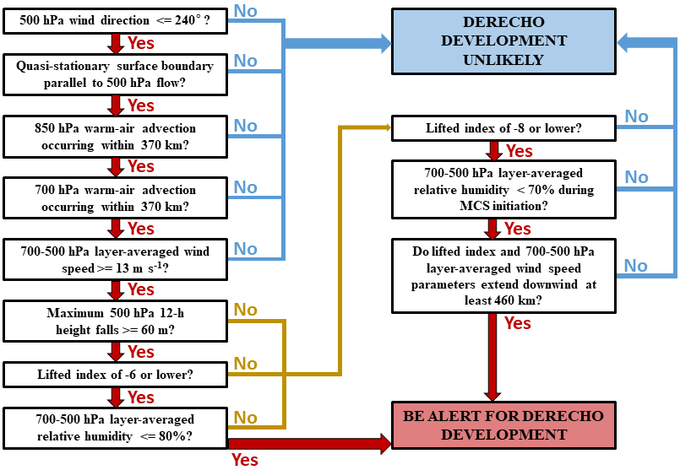

Slide 48
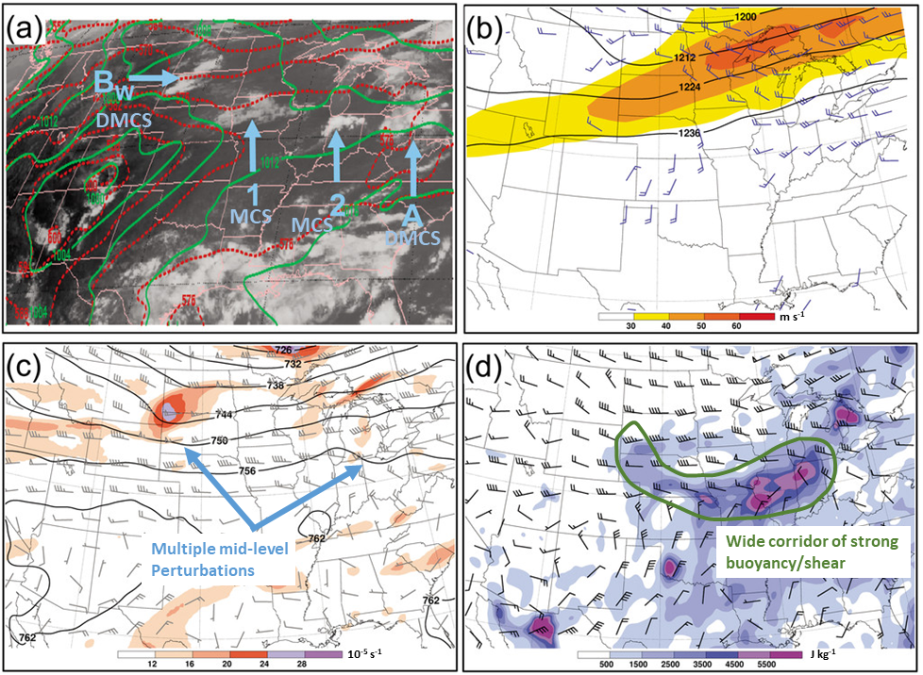

Slide 49
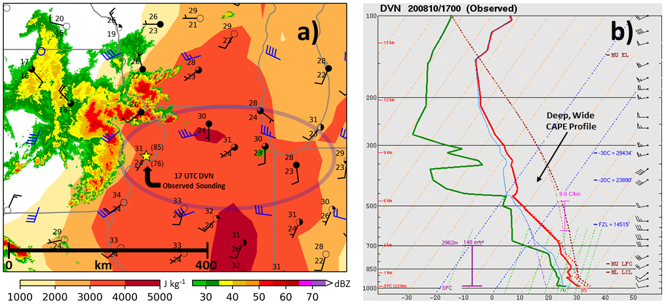
10 Aug 2020 – 1700 UTC

Slide 50
More dry air aloft supports stronger evaporative cooling
Greater evaporative cooling can support greater downward momentum transport of RIJ air over a broader area
Severe winds can be more prolonged compared to ordinary squall-line/MCS cases

Slide 51
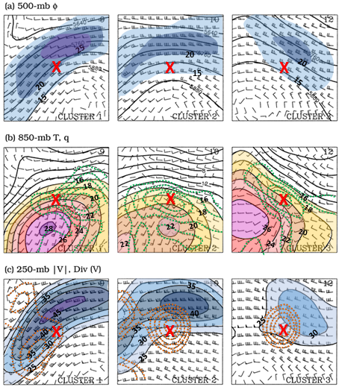

Slide 52
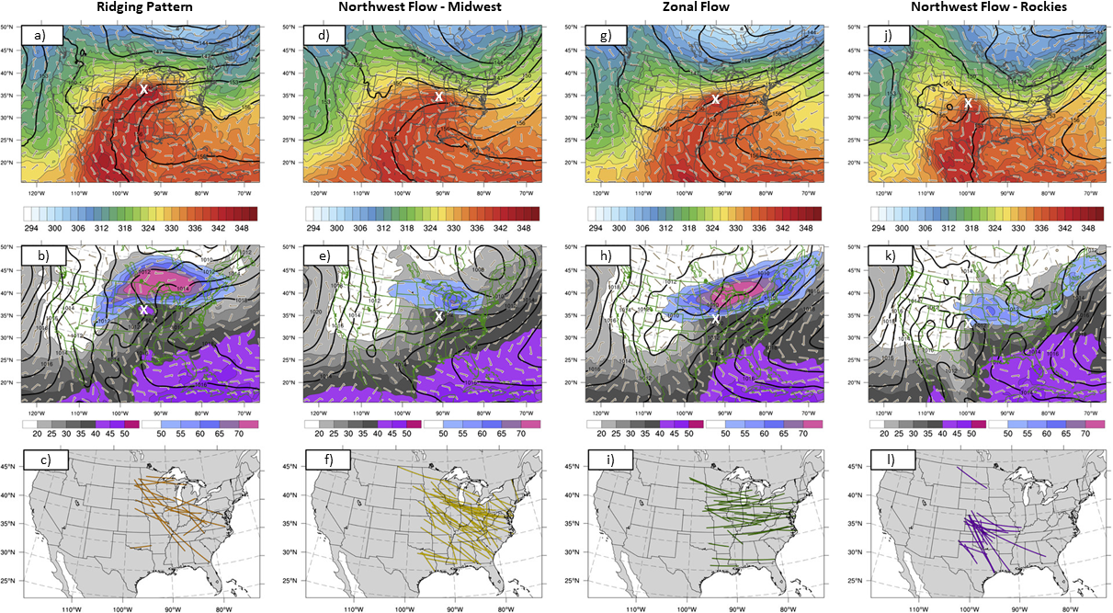

Slide 53
Understanding derecho synoptic setups
Many of the aforementioned synoptic regimes can support relatively weaker, shorter-lived wind swaths from cold-pool dominated MCSs.
Previous studies were less strict in identifying derechos from a phenomenalogical standpoint, and they had much more lenient quantitative wind-report criteria.
Even if confidence is high in an MCS materializing in a weakly forced environment (which is a tremendous challenge in of itself), how can we distinguish between the rarer but disproportionately more intense/impactful cold pool MCS wind swaths from the less impactful but more common occurrences?

Slide 54
Understanding derecho synoptic setups
New research is underway to determine what supports particularly intense wind swaths that specifically originate from cold pool dominated MCSs (i.e. the “you know it when you see it” scenarios).
Latest research shows that in addition to strong buoyancy, strong mid/upper-level flow/shear is a good discriminator between MCSs producing destructive wind swaths, and lesser events in otherwise identical synoptic flow patterns.

Slide 55
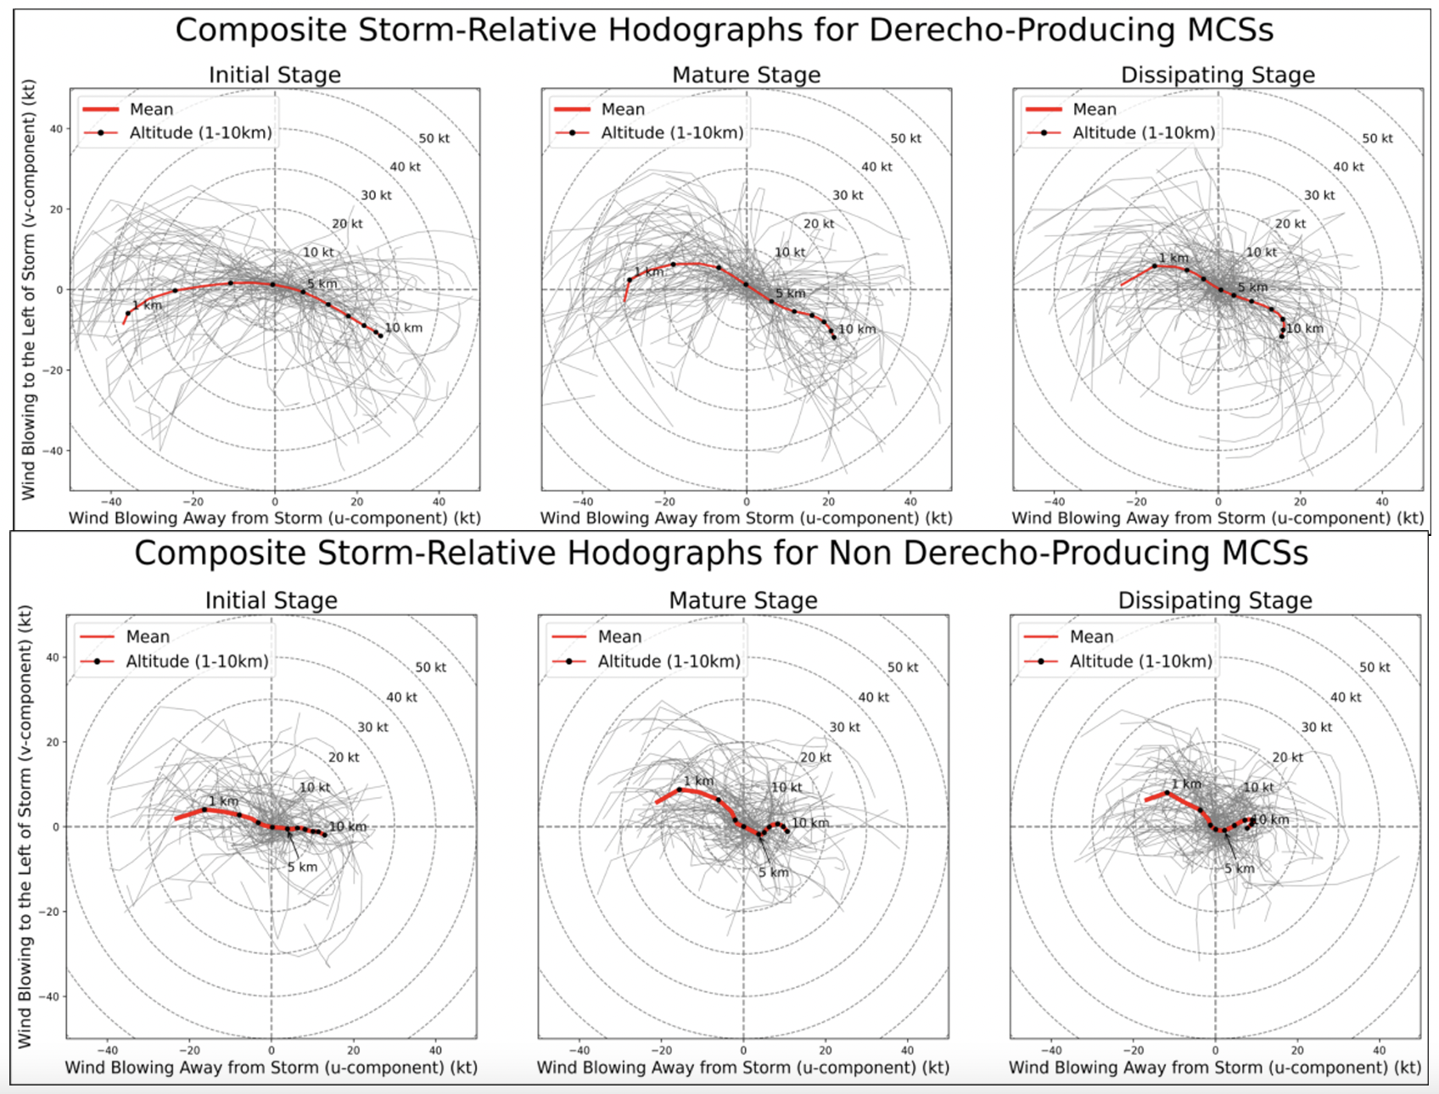
OU capstone:
Parker Alvstad
Lydia Burroughs
Taylor King
Manual hourly tracking of ~20 DMCSs and ~20 non-DMCSs in similar patterns RUC/RAP proximity

Slide 56
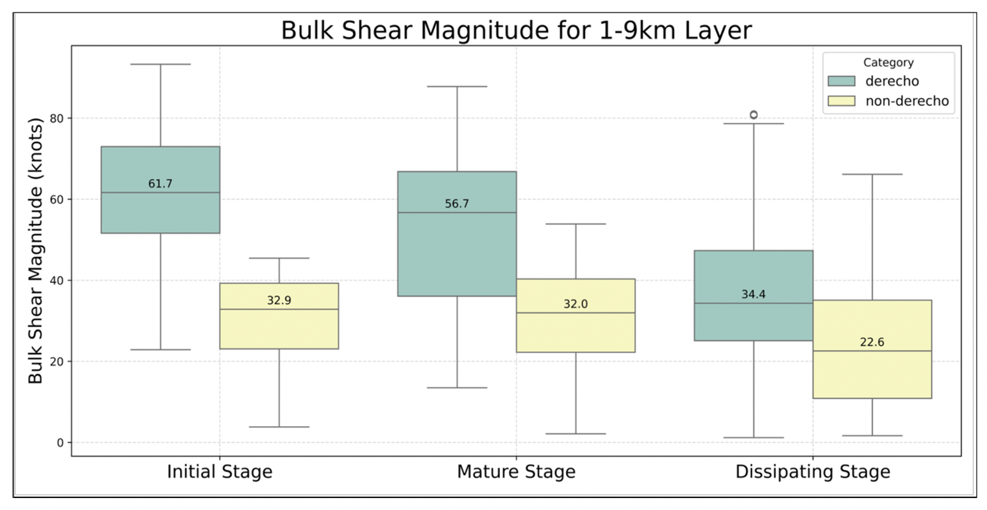

Slide 58
High CAPE favors stronger updrafts with greater updraft buoyancy.

Slide 59
High CAPE favors stronger updrafts with greater updraft buoyancy.
This leads to a deeper cold pool and a stronger mid-level pressure deficit.

Slide 60
High CAPE favors stronger updrafts with greater updraft buoyancy.
This leads to a deeper cold pool and a stronger mid-level pressure deficit.
The deeper cold pool and stronger pressure deficit supports a stronger rear-inflow jet.

Slide 61
High CAPE favors stronger updrafts with greater updraft buoyancy.
This leads to a deeper cold pool and a stronger mid-level pressure deficit.
The deeper cold pool and stronger pressure deficit supports a stronger rear-inflow jet.

Slide 62
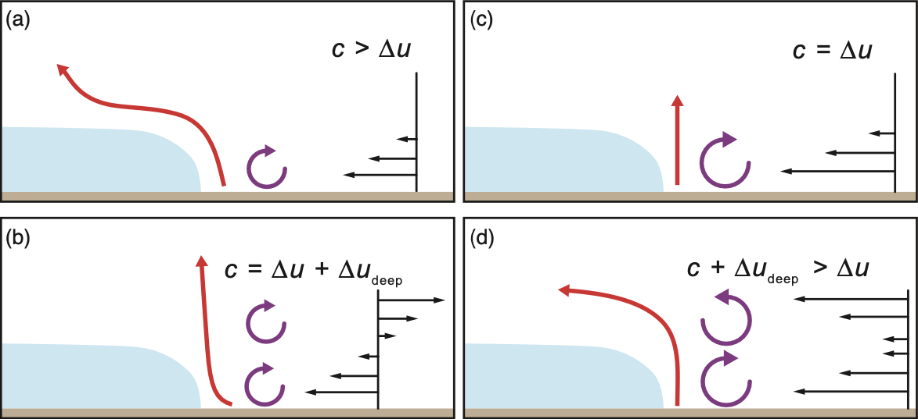
High CAPE favors stronger updrafts with greater updraft buoyancy.
This leads to a deeper cold pool and a stronger mid-level pressure deficit.
The deeper cold pool and stronger pressure deficit supports a stronger rear-inflow jet.

Slide 63
High CAPE favors stronger updrafts with greater updraft buoyancy.
This leads to a deeper cold pool and a stronger mid-level pressure deficit.
The deeper cold pool and stronger pressure deficit supports a stronger rear-inflow jet.
However, stronger mid/upper level flow/shear also supports stronger/deeper storm-scale circulations, which also promote more upright updrafts.

Slide 64
High CAPE favors stronger updrafts with greater updraft buoyancy.
This leads to a deeper cold pool and a stronger mid-level pressure deficit.
The deeper cold pool and stronger pressure deficit supports a stronger rear-inflow jet.
However, stronger mid/upper level flow/shear also supports stronger/deeper storm-scale circulations, which also promote more upright updrafts.
Updrafts benefitting from stronger deep-layer flow/shear have a better chance at sustaining against a deep, intense/progressive cold pool.

Slide 65
High CAPE favors stronger updrafts with greater updraft buoyancy.
This leads to a deeper cold pool and a stronger mid-level pressure deficit.
The deeper cold pool and stronger pressure deficit supports a stronger rear-inflow jet.
However, stronger mid/upper level flow/shear also supports stronger/deeper storm-scale circulations, which also promote more upright updrafts.
Updrafts benefitting from stronger deep-layer flow/shear have a better chance at sustaining against a deep, intense/progressive cold pool.
This scenario prevents updrafts from tilting rearward too heavily, too quickly, which can reduce MCS intensity and perhaps wind-swath efficiency.

Slide 66
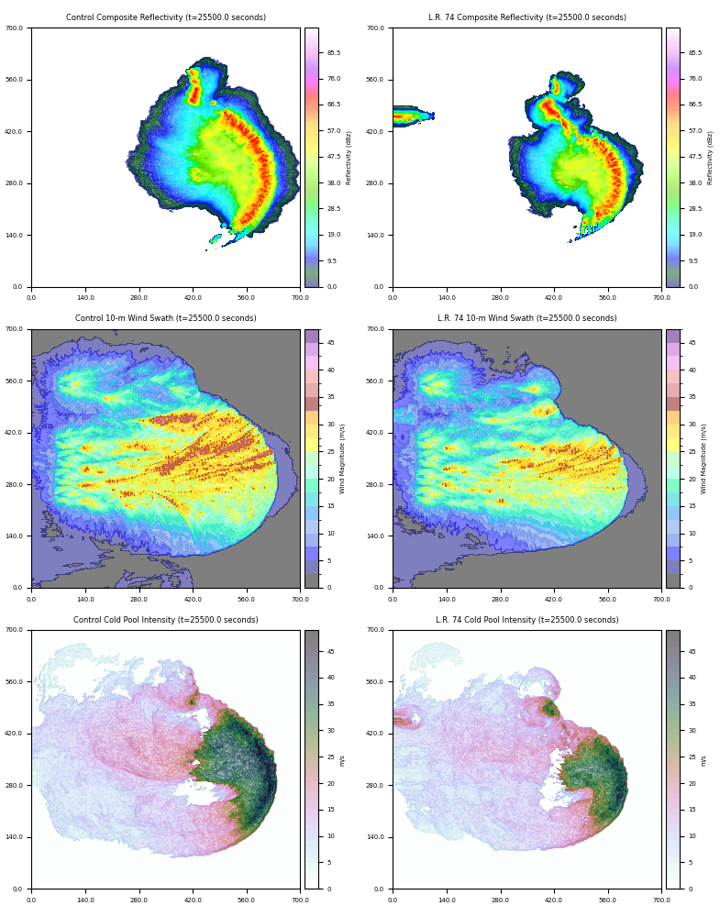
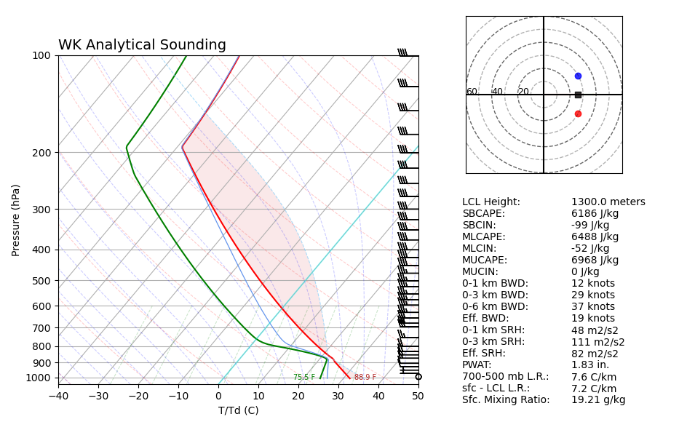
Control (7.6)
7.4
7.2
7.0
6.8
6.6
MCS Intensity with 700-500 mb lapse rate

Slide 67
Recommended Reading
Squitieri, B. J., A. R. Wade, and I. L. Jirak, 2023a: A historical overview on the science of derechos. Part I: Identification, climatology, and societal impacts. Bull. Amer. Meteor. Soc., 104, E1709–E1733, https://doi.org/10.1175/BAMS-D-22-0217.1
Squitieri, B. J., A. R. Wade, and I. L. Jirak, 2023b: A historical overview on the science of derechos. Part II: Parent storm structure, environmental conditions, and history of numerical forecasts. Bull. Amer. Meteor. Soc., 104, E1734-E1763, https://doi.org/10.1175/BAMS-D-22-0278.1
Squitieri, B. J., A. R. Wade, and I. L. Jirak, 2025a: On a modified definition of a derecho. Part I: Construction of the definition and quantitative criteria for identifying future derechos over the contiguous U.S. Bull. Amer. Meteor. Soc., 106, E84-E110, https://doi.org/10.1175/BAMS-D-24-0015.1.
Squitieri, B. J., A. R. Wade, and I. L. Jirak, 2025b:On a modified definition of a derecho. Part II: An updated spatial climatology of derechos across the contiguous United States. Bull. Amer. Meteor. Soc., 106, E111-E124, https://doi.org/10.1175/BAMS-D-24-0140.1.

